Slide 1
RaiderNAV
Team 7: Getana
By: Arpit Desai, Brody Williams, Michael Acosta, Sakshyam Silwal, Vasilis Vloutis, Yong Wu

Slide 2
What is RaiderNAV?
RaiderNAV is an Android-only application and is intended to provide college students at Texas Tech University with a better way to find their classes, navigate through campus, and schedule their day.
Knows where every building on campus is
Provides GPS-guided directions and map
Has an (in progress) class schedule builder
https://github.com/aluminiumi/RaiderNAV/raw/master/app/release/app-release.apk
Notes:
Arpit

Slide 3
Updates from Proposal
Unscheduled navigation
Added 15 user stories (21-35)
For example:
Use case 30: As a user, I want to be asked to verify before a schedule or course is deleted, so that I do not accidentally delete a schedule. (Implemented)
Use case 31: As a user, I want the ability to share a location with others who do not have the app, so that I can easily communicate an intended location to friends. (Not yet implemented)
https://github.com/aluminiumi/RaiderNAV/raw/master/app/release/app-release.apk
Notes:
Yong

Slide 4
Functional Requirements
1.1.1 The system shall allow the user to add new courses to a schedule based on the name or prefix of the building, days of the week, and time of the class.
2.1.1 The system shall allow the user to save any created schedule with a user-given name.
2.1.2 The system shall maintain a list of scheduled events (e.g., individual courses) within each schedule.
5.1.1 The system shall intelligently determine the on-campus location of each of the user’s classes based only on the building name or prefix entered by the user during schedule input.
6.1.1 The system shall dynamically generate the user’s route based on the selected schedule and time of day.
https://github.com/aluminiumi/RaiderNAV/raw/master/app/release/app-release.apk
Notes:
Brody

Slide 5
Non-functional Requirements
2.2.1 The system shall not require more than 2 seconds to save a schedule, 95% of the time.
4.3.1 The system shall store the user’s list of saved schedules in a single file not exceeding 25MB.
5.3.1 The system shall correctly process all building to physical location mappings for a given schedule within 3 seconds, 95% of the time.
8.2.1 The system must connect with Google Maps API, input the destinations, and respond to the users with the shortest route between classes in less than 5 seconds, 95% of the time.
https://github.com/aluminiumi/RaiderNAV/raw/master/app/release/app-release.apk
Notes:
Brody

Slide 6
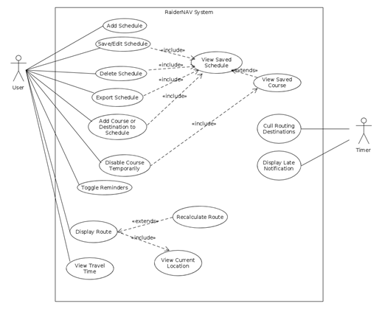
Use Cases
Total of 35 use cases
Example 1: User creates a new class schedule
Description:
1. User presses Create New Schedule button on the My Schedules screen.
2. The application prompts the user to enter the schedule name.
3. User inputs schedule name and presses OK.
4. The system adds the schedule to a visible list on the My Schedules screen.
Alternatives:
3a. The user presses Cancel
3a.1 The system displays the My Schedules screen.
https://github.com/aluminiumi/RaiderNAV/raw/master/app/release/app-release.apk
Notes:
Yong

Slide 7
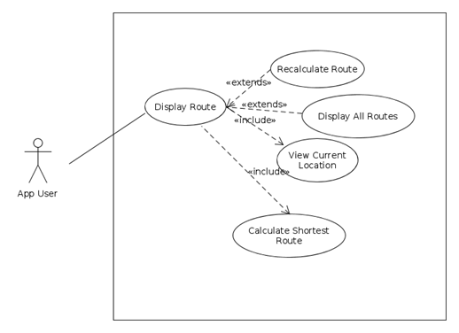
Use Cases (cont.)
Example 2: Calculate Shortest Route
Description:
1. The user long presses to select a starting point on the map.
2. The system displays a marker over the user’s starting point on the map.
3. The user long presses to select a destination on the map.
4. The system displays a marker over the user’s destination on the map, along with a shortest-path between the two points.
https://github.com/aluminiumi/RaiderNAV/raw/master/app/release/app-release.apk
Notes:
Yong

Slide 8
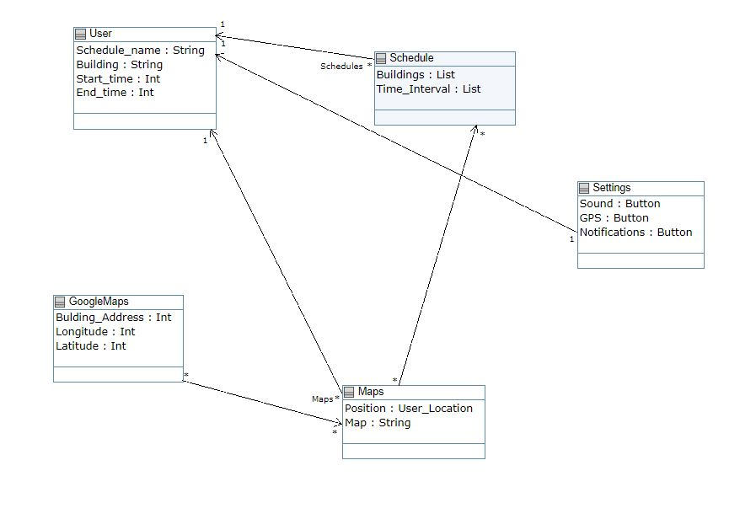
Domain
Model
https://github.com/aluminiumi/RaiderNAV/raw/master/app/release/app-release.apk
Notes:
Michael

Slide 9
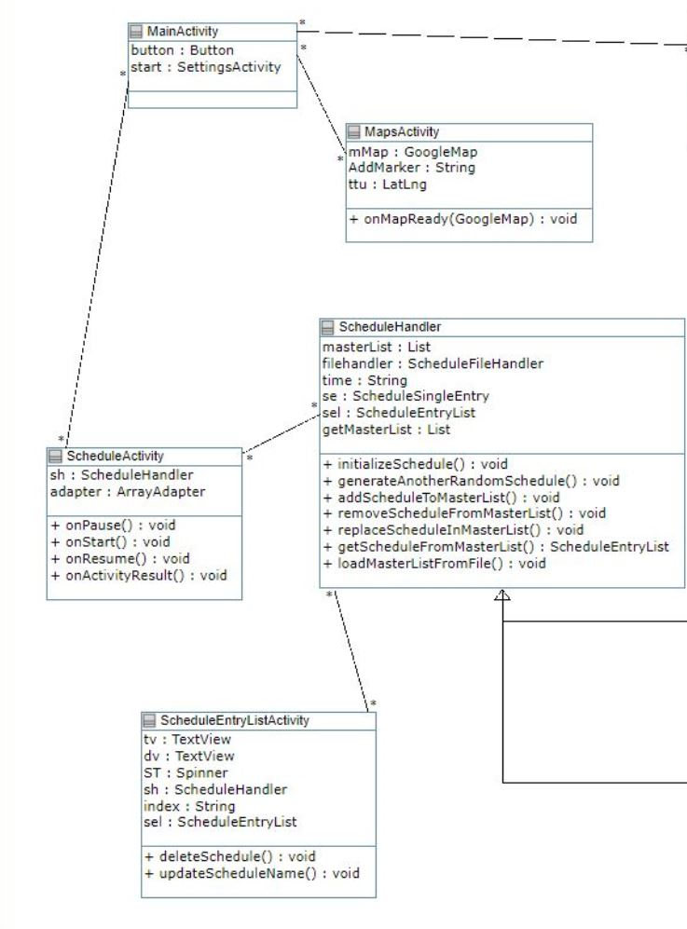
Detailed
Design
Model
https://github.com/aluminiumi/RaiderNAV/raw/master/app/release/app-release.apk
Notes:
Michael

Slide 10
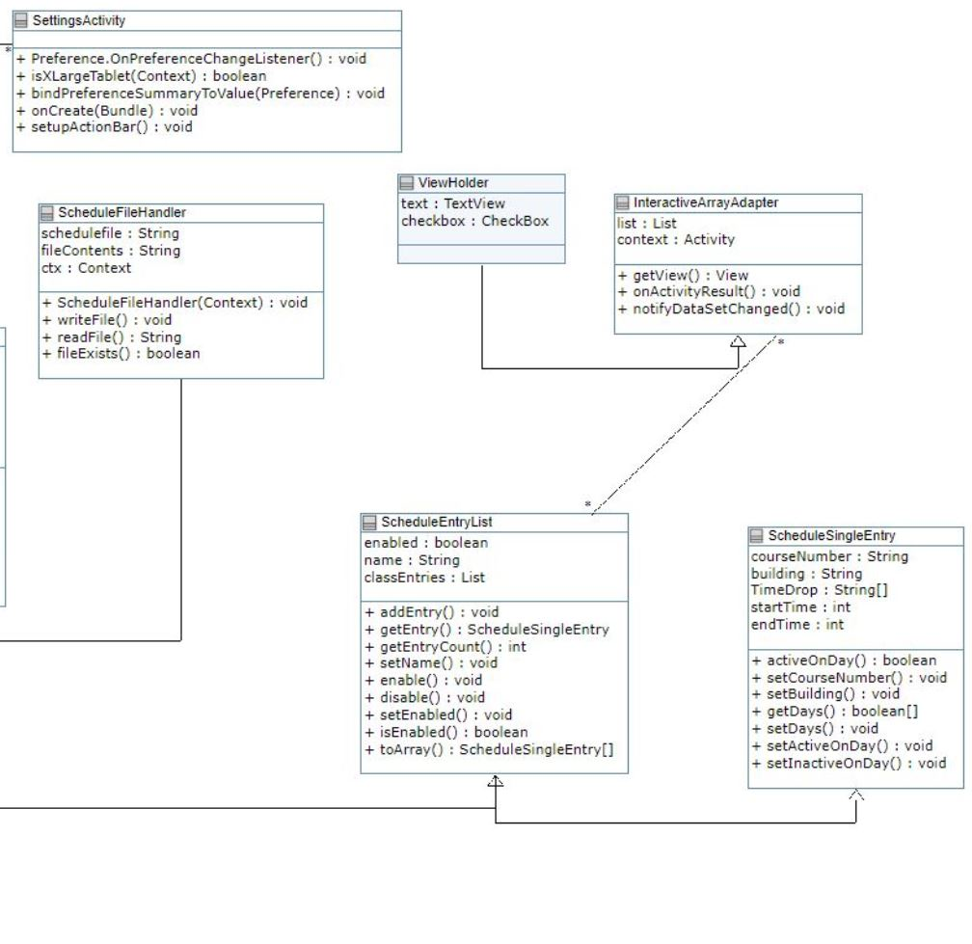
Detailed
Design
Model
https://github.com/aluminiumi/RaiderNAV/raw/master/app/release/app-release.apk
Notes:
Michael

Slide 11
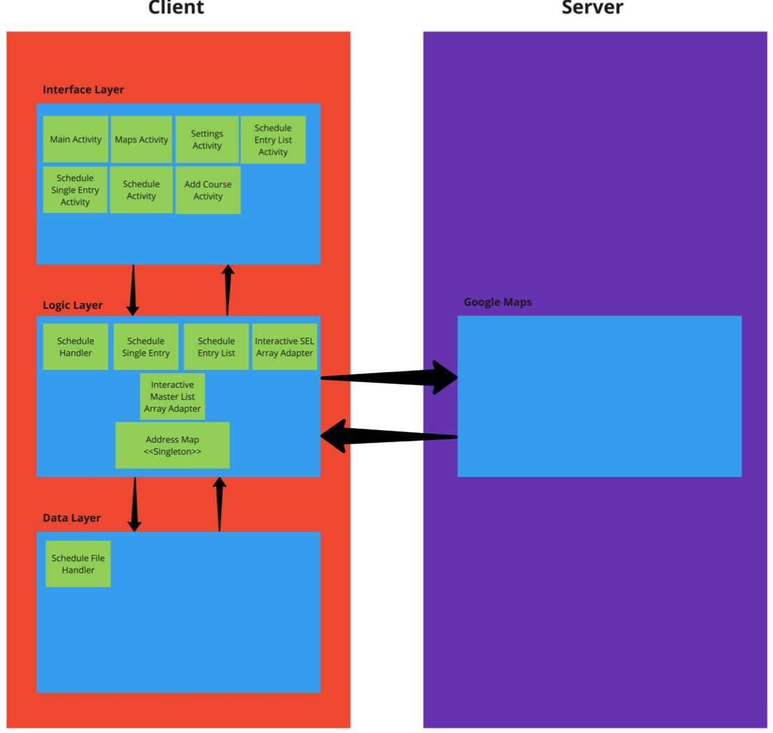
Architectural Design
The RaiderNAV Architecture is based on a hybrid of the layered & client-server architectural patterns.
The app itself comprises the client side of the interaction and is itself composed of three layers: an interface layer, a logic layer, and a data layer.
The server side is represented by the Google Maps API backend.
https://github.com/aluminiumi/RaiderNAV/raw/master/app/release/app-release.apk
Notes:
Brody

Slide 12
Design Patterns
Observer - Interface layer Android activity classes are examples of the observer pattern
Each presents information regarding saved schedules or other available options
Are themselves decoupled from the stored information
Allow the user to modify this data through an easy to use interface
https://github.com/aluminiumi/RaiderNAV/raw/master/app/release/app-release.apk
Notes:
Brody

Slide 13
Design Patterns (cont.)
Singleton - AddressMap class
A public final class that contains a private static HashMap “Coordinates”
Maps building names and prefixes to geographic coordinates
Is initialized on app startup
Utilized throughout the app via its public methods
https://github.com/aluminiumi/RaiderNAV/raw/master/app/release/app-release.apk
Notes:
Brody

Slide 14
Design Patterns (cont.)
Composite - ScheduleSingleEntry & ScheduleEntryList classes
ScheduleSingleEntry holds the attributes attached to a single course within a schedule: course name, building, start & end times, and days the course is held.
ScheduleEntryList further encapsulates all the courses contained in a single schedule into an ArrayList.
https://github.com/aluminiumi/RaiderNAV/raw/master/app/release/app-release.apk

Slide 15
Design Patterns (cont.)
Adapter - InteractiveSELArrayAdapter & InteractiveMasterListArrayAdapter classes
Basically do what you would expect
InteractiveSELArrayAdapter converts array of single courses into format usable by interface layer to be displayed in ListView
InteractiveMasterListArrayAdapter likewise facilitates displaying list of schedules
https://github.com/aluminiumi/RaiderNAV/raw/master/app/release/app-release.apk

Slide 16
Unit Testing
AddressMapUnitTest: 8/8 unit tests passed
ScheduleEntryListUnitTest: 10/10 unit tests passed
ScheduleSingleEntryUnitTest: 13/13 unit tests passed
Also TravisCI
No UI unit tests (a la Espresso)
https://github.com/aluminiumi/RaiderNAV/raw/master/app/release/app-release.apk
Notes:
Vasilis

Slide 17
Acceptance Testing
Criteria: User stories 1-6, 8, 10-16, 21, 24, 29-30 implemented
Usability test score represents >= 90% success rate
Results: User stories 1-5, 8, 19, 21, 24, 29-30 implemented
92.8% success rate
Decision: Rejected. User stories 6 and 10-16 not implemented.
https://github.com/aluminiumi/RaiderNAV/raw/master/app/release/app-release.apk
Notes:
Vasilis

Slide 18
Use Case Testing
Total of 13 use cases were tested
Most of them passed
Two bugs were found
Example: Time-overlapped courses should not be saved.
https://github.com/aluminiumi/RaiderNAV/raw/master/app/release/app-release.apk
Notes:
Yong

Slide 19
Testing Summary
All unit tests passed
Use case testing shows that most alternatives have been well-addressed
App does not yet meet criteria set during acceptance testing
Conclusion: All implemented features and functionality have been done well, but significant components still need to be completed before release.
https://github.com/aluminiumi/RaiderNAV/raw/master/app/release/app-release.apk
Notes:
Brody

Slide 20
Privacy/Security Concerns
The Objective: Privacy by Design
Collect only the minimum information (i.e., location) necessary to do our job
Only transmit what/to whom is necessary (i.e., locations to Google)
Encrypt all transmissions
Store everything else (e.g., schedules) locally and securely
Empower the user with knowledge of and control over information
https://github.com/aluminiumi/RaiderNAV/raw/master/app/release/app-release.apk
Notes:
Vasilis

Slide 21
Privacy/Security Concerns (cont.)
Hurdles
Imported libraries (Google Maps) request unnecessary permissions:
Identification, Phone, Shell, Contacts, Email
Time Constraints
Prohibitive to implementing improved privacy features and seeking alternative libraries
https://github.com/aluminiumi/RaiderNAV/raw/master/app/release/app-release.apk
Notes:
Vasilis

Slide 22
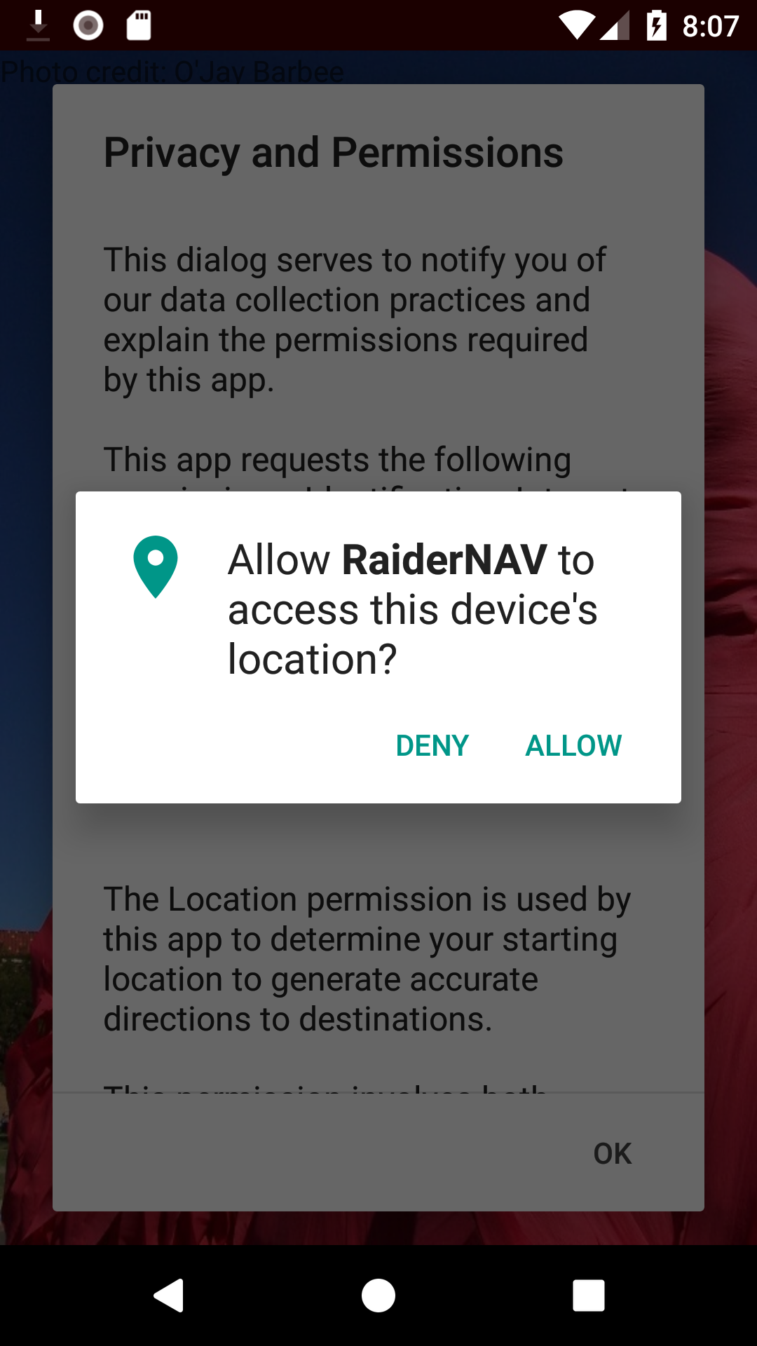
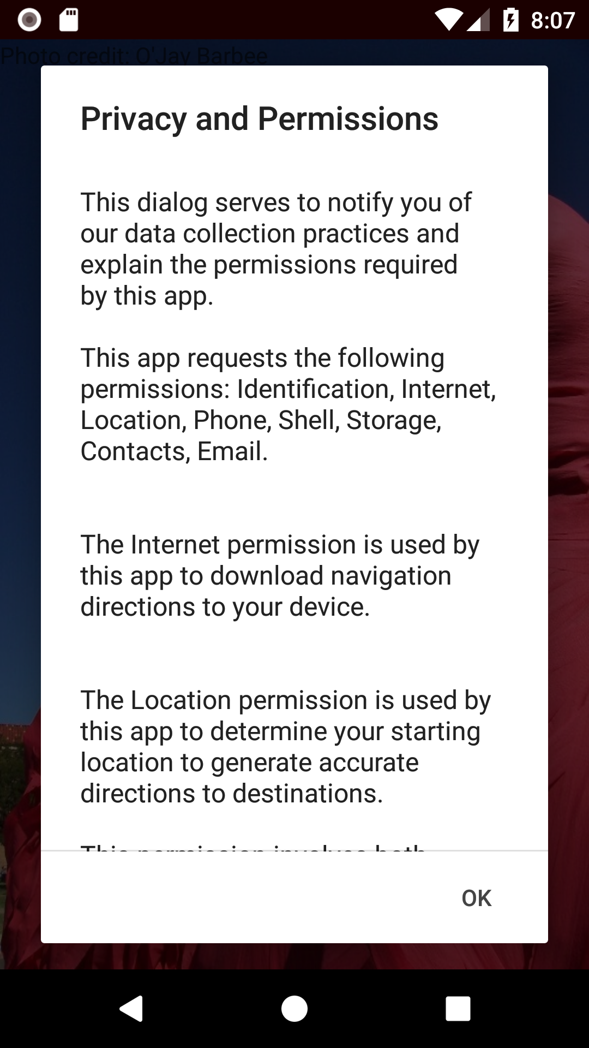
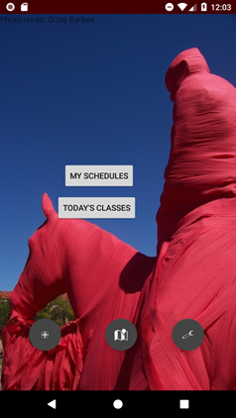
Mock-up
https://github.com/aluminiumi/RaiderNAV/raw/master/app/release/app-release.apk
Notes:
Michael

Slide 23
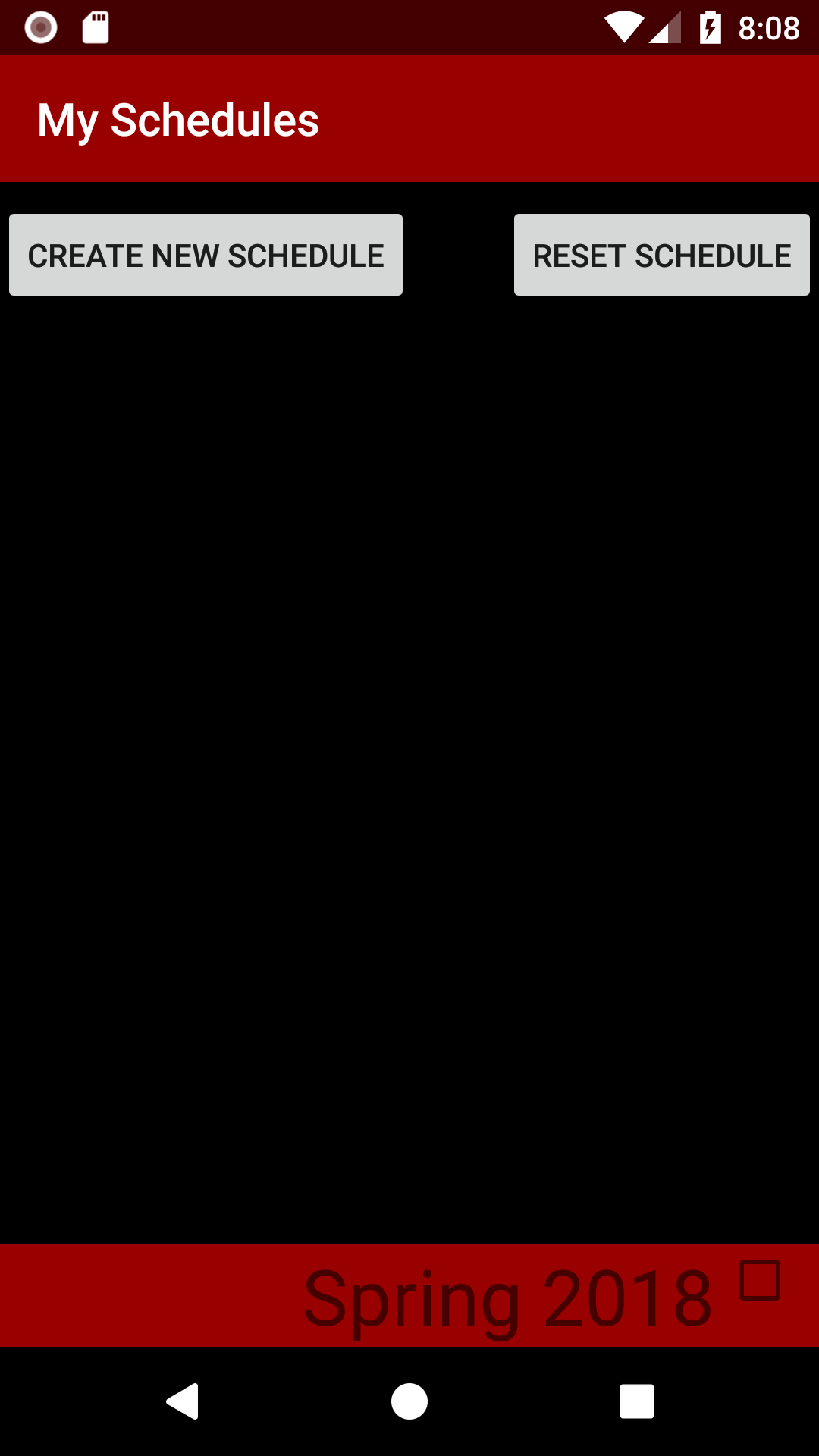
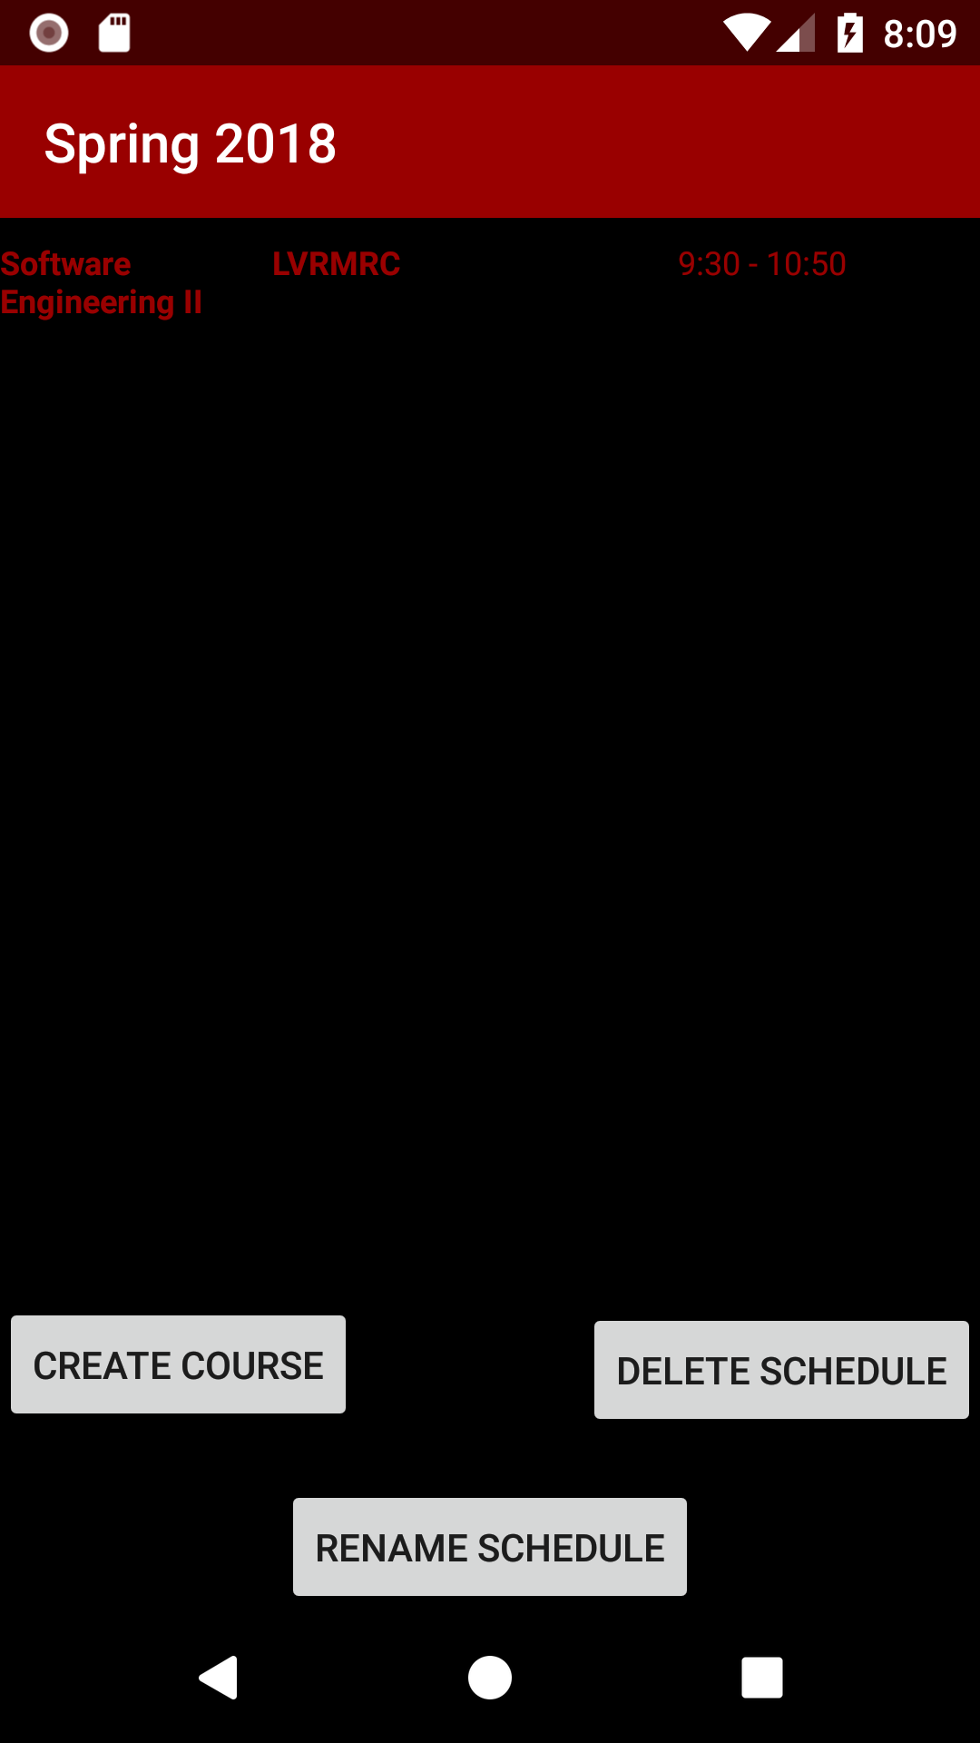
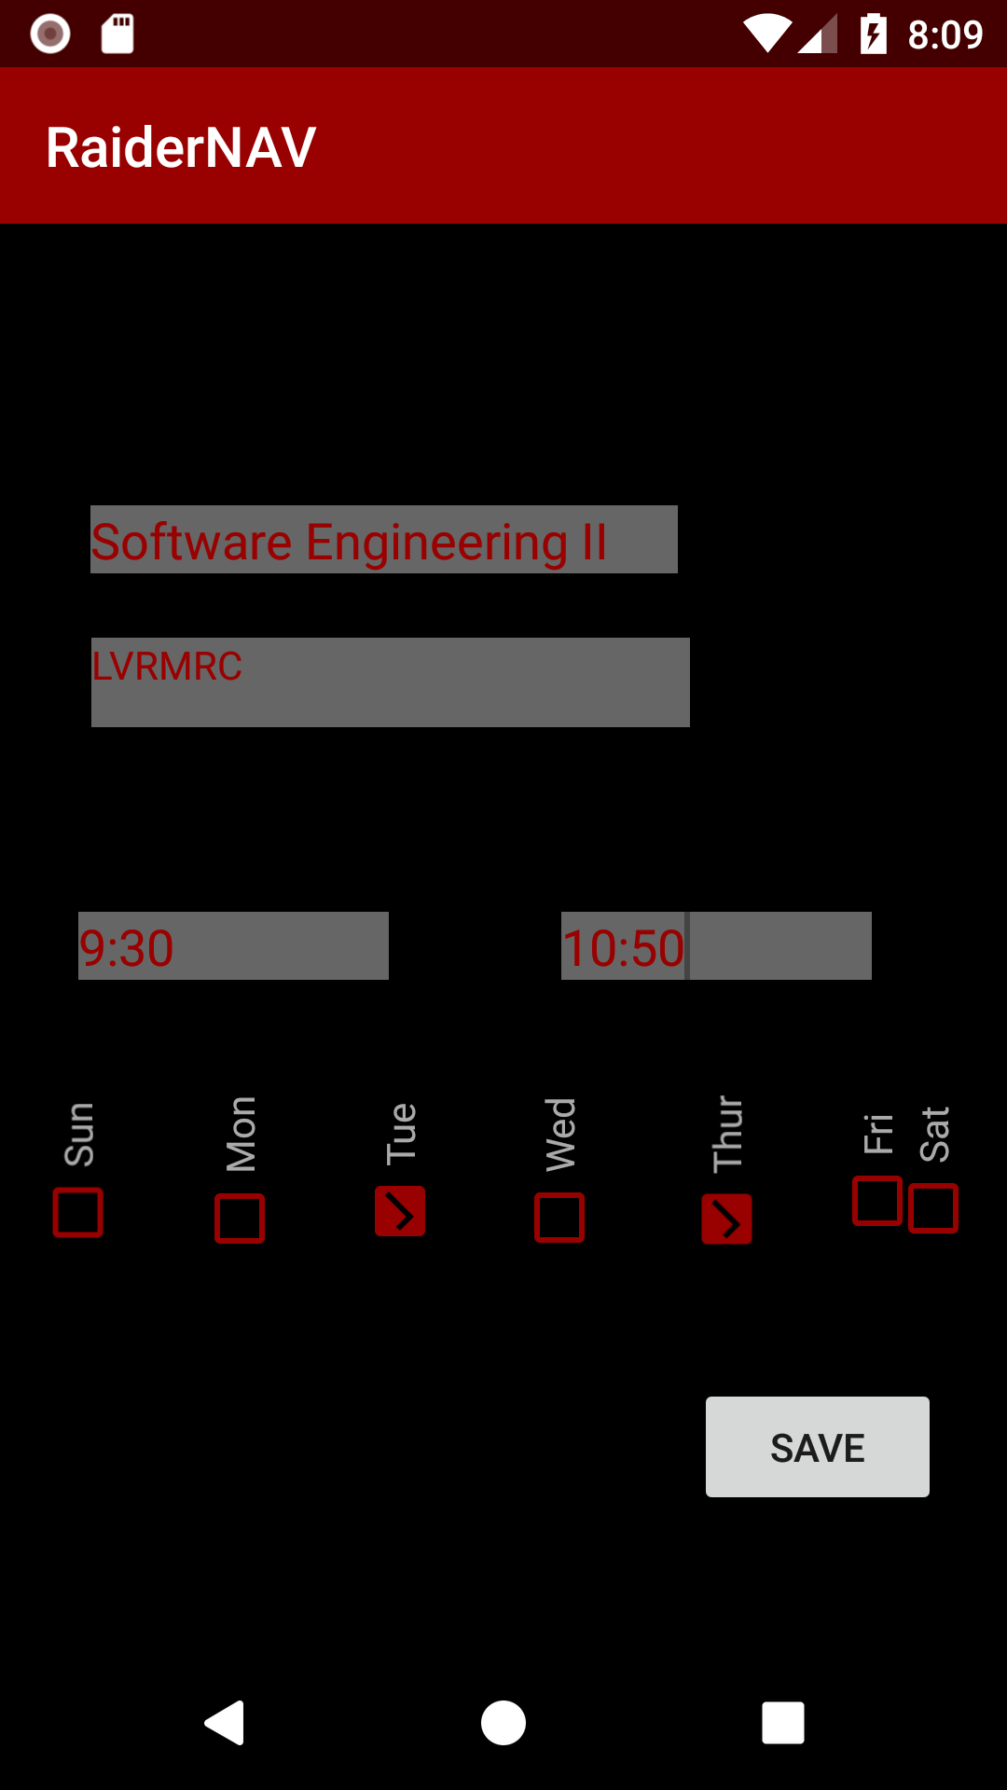
Mock-up
Notes:
Michael

Slide 24
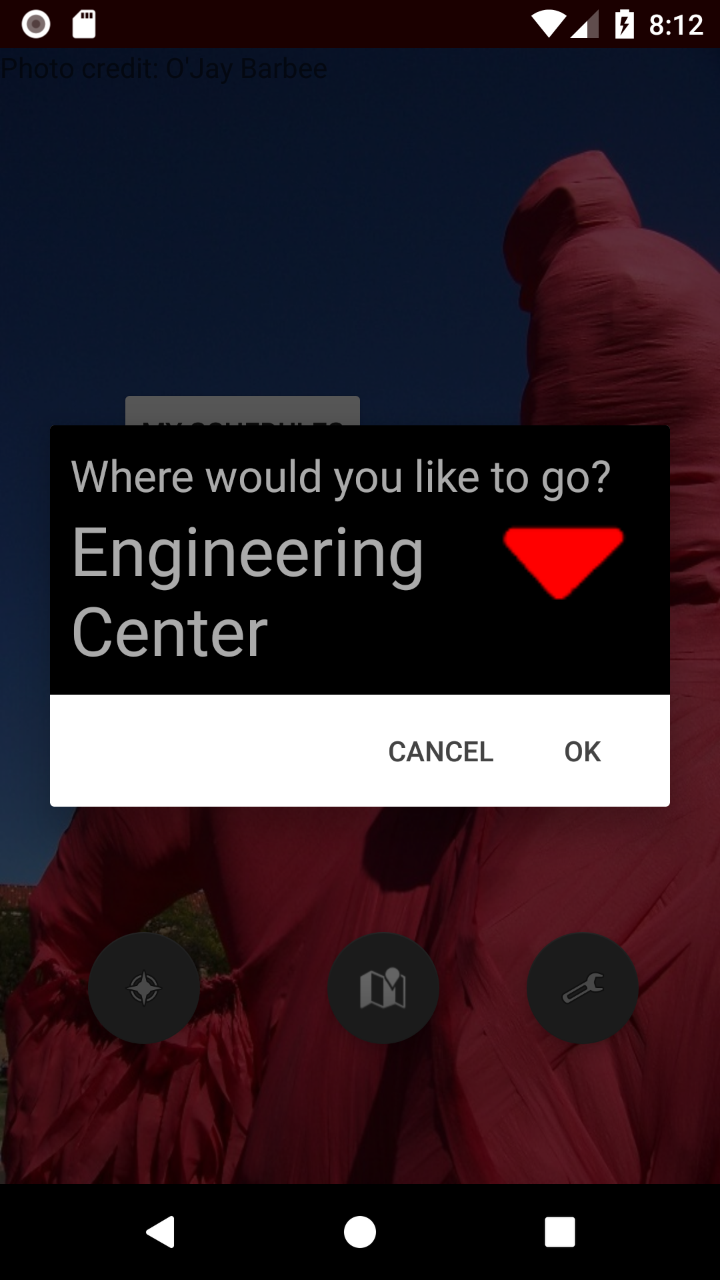
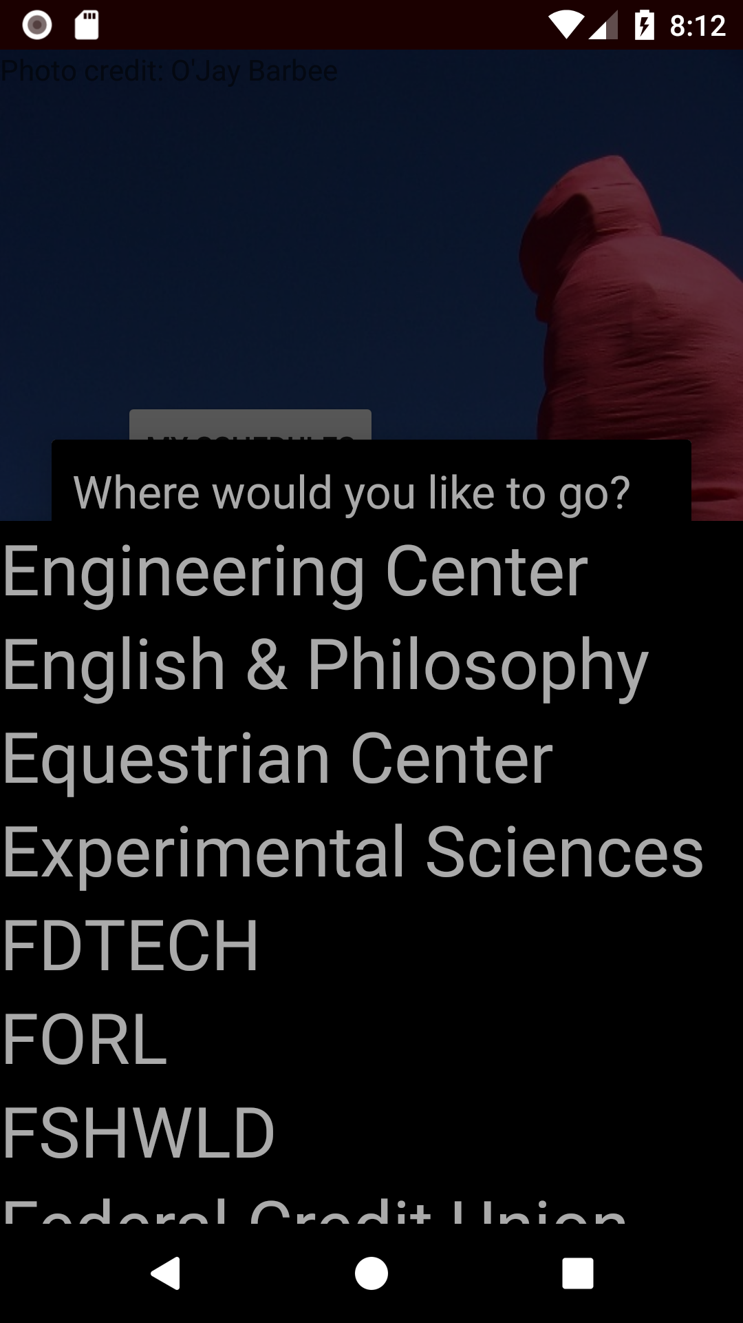
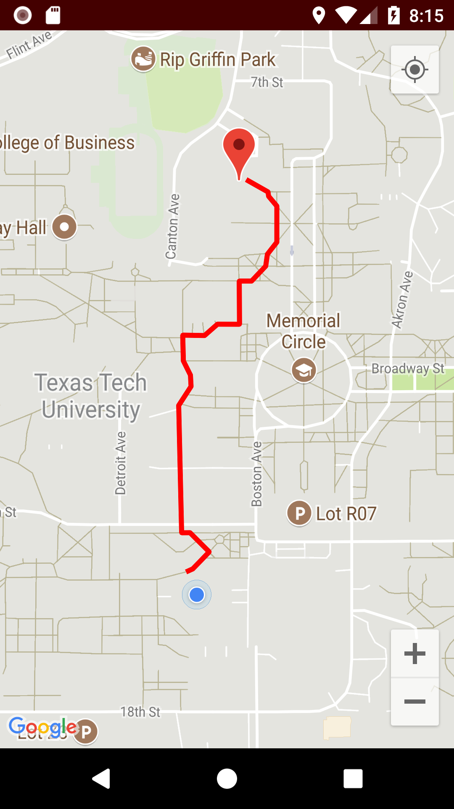
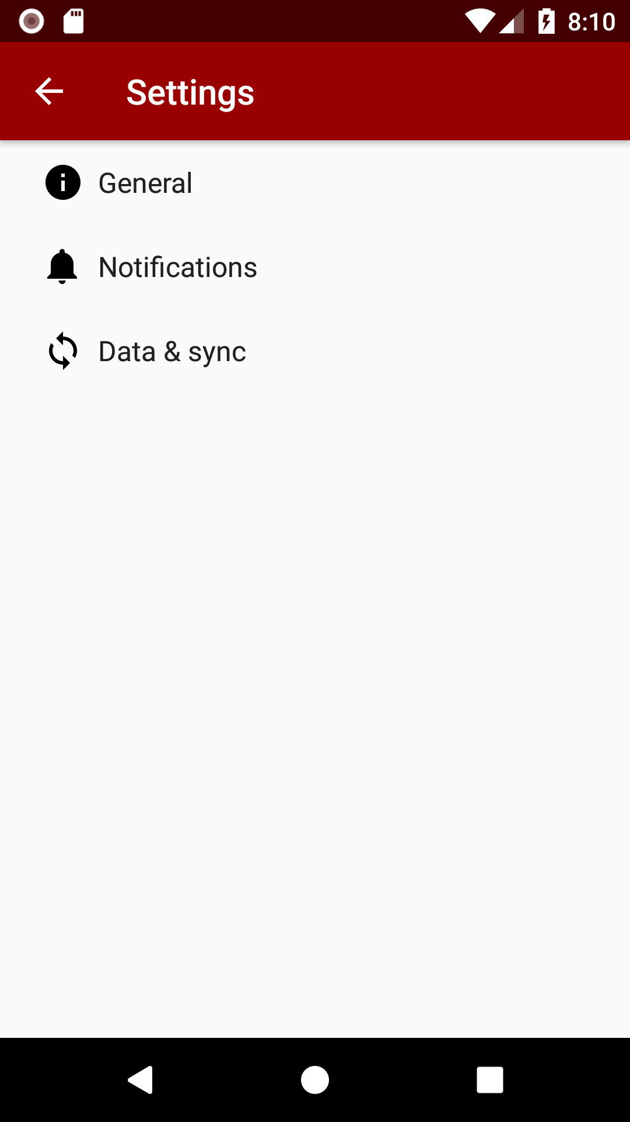
Mock Ups

Slide 25
Demo
https://github.com/aluminiumi/RaiderNAV/raw/master/app/release/app-release.apk
Notes:
Michael

Slide 26
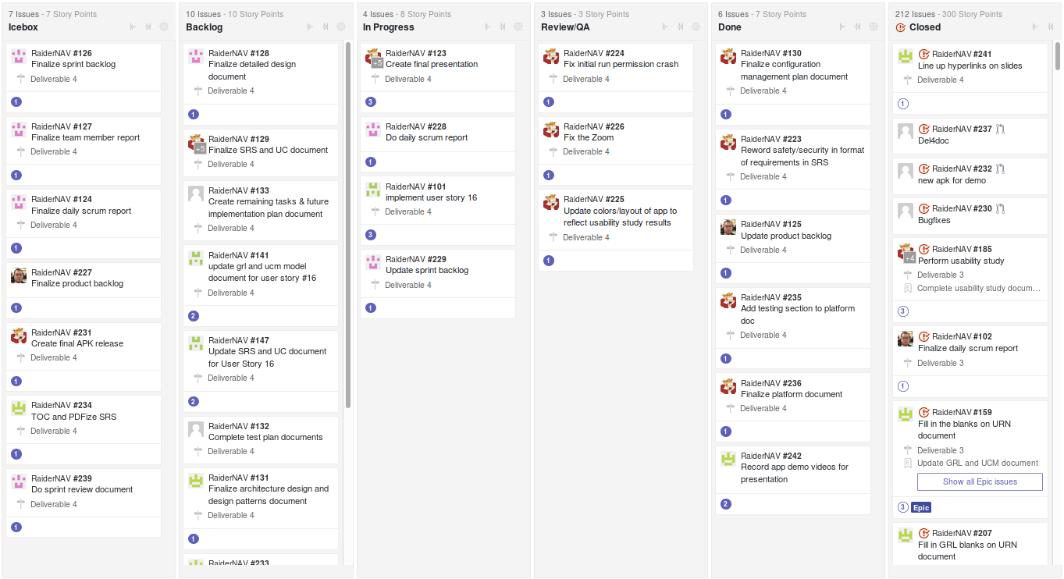
Kanban Board
https://github.com/aluminiumi/RaiderNAV/raw/master/app/release/app-release.apk
Notes:
Sakshyam

Slide 27
Configuration Management Plan
Eighteen glorious pages of IEEE 828-2005 compatible rules
In a nutshell:
Loose formality/application under time constraints
Defines SCM duties of each scrum role (casually observed)
Defines baselines (and their procedures) around deliverables
Describes how each item is controlled for change, including itself
https://github.com/aluminiumi/RaiderNAV/raw/master/app/release/app-release.apk
Notes:
Vasilis

Slide 28
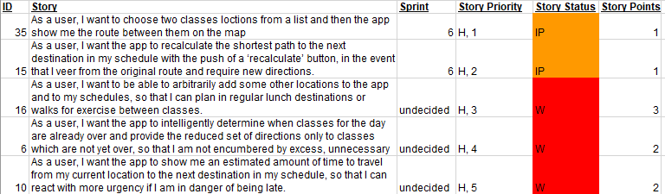
Product Backlog
https://github.com/aluminiumi/RaiderNAV/raw/master/app/release/app-release.apk
Notes:
Yong

Slide 29
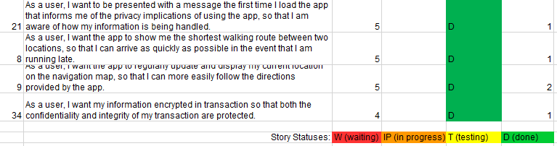
Product Backlog
Backlog form continued:
https://github.com/aluminiumi/RaiderNAV/raw/master/app/release/app-release.apk
Notes:
Yong

Slide 30
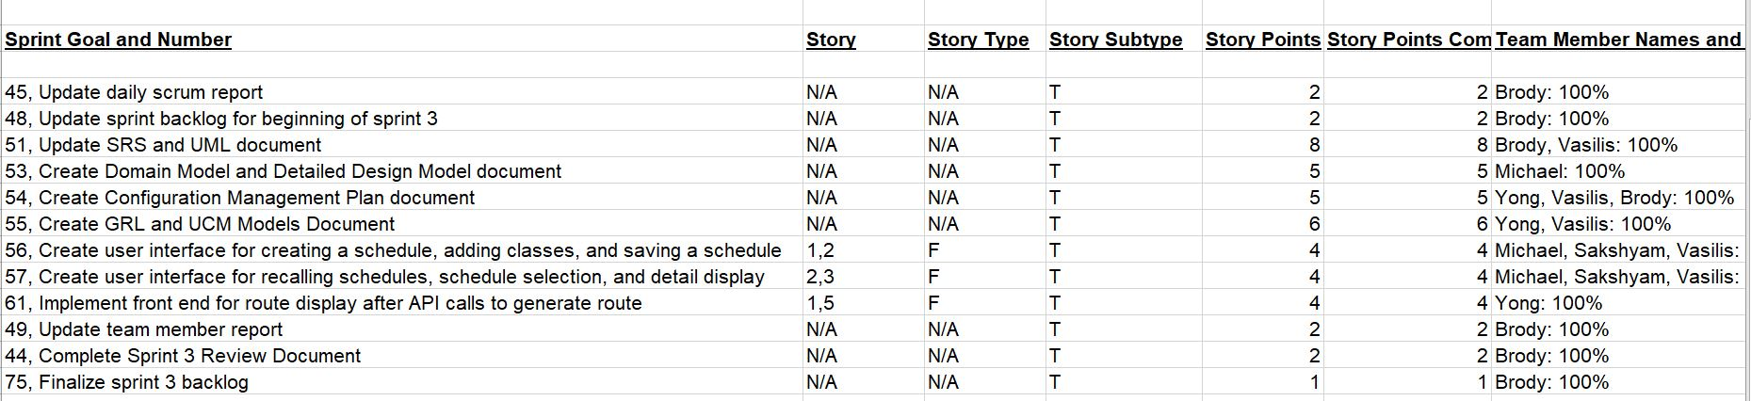
Sprint Backlog
https://github.com/aluminiumi/RaiderNAV/raw/master/app/release/app-release.apk
Notes:
Sakshyam

Slide 31
Who Did What
Almost Everyone: Scrum Master duties, Product Owner duties, Development, URN + SRS for implemented stories, Usability study
Brody: Architecture Design & Design Patterns
Michael: Domain Model & Detailed Design, Mockups
Sakshyam: Unit testing, Mockups
Vasilis: SCMP, Unit testing, Acceptance testing
Yong: Use Case testing
https://github.com/aluminiumi/RaiderNAV/raw/master/app/release/app-release.apk
Notes:
Vasilis

Slide 32
What is left?
21 stories still incomplete
Among those, the highest priority are…
-Adding a notification feature
-Sharing location among friends
-Adding food locations to the application
-Improving UI design
https://github.com/aluminiumi/RaiderNAV/raw/master/app/release/app-release.apk
Notes:
Sakshyam

Slide 33
App URL
https://bit.ly/2JBG55F
https://github.com/aluminiumi/RaiderNAV/raw/master/app/release/app-release.apk

Slide 34
Thanks!
Any questions?
https://github.com/aluminiumi/RaiderNAV/raw/master/app/release/app-release.apk

